Slide 1


Savitribai Phule Pune University, Pune Amrutvahini College Of Engineering, Sangamner Department of E&TC Engineering A Presentation on
“Vehicle black box for accident data storage and
alert system using GSM and GPS technology”
Presented By
B.E. (E&TC)
Under the Guidance of
Dr. S.R.Gagare
Mr. BHAGAT SHIVAM TUKARAM
Mr. CHINDHE RUTURAJ ANIL
Mr. DESHMUKH RUPESH KAILAS
Mr. KANK VAIBHAV RAM

Slide 2
Contents
Introduction
Need of project
Research motivation
Aim and objective of project
Literature Survey
Problem Statement (Title of Project)
Block Diagram of Project
Explanation of Block Diagram
Flow chart
Conclusion
References

Slide 3
Introduction
The Vehicle Accident Detection and Alert System is an advanced safety innovation using ATmega2560 microcontroller and various sensors to enhance road safety.
It monitors critical aspects of vehicle operation and driver behavior, including speed, tire pressure, and temperature, to prevent accidents.
The system promotes responsible driving with alcohol and seat belt sensors and assesses driver alertness through an eye blink sensor.
It can anticipate accidents using ADXL345 and flex sensors, triggering automatic alerts to the nearest hospital with GPS technology.
This comprehensive system combines technology, data analysis, and proactive measures to create a safer driving environment and demonstrates innovation's role in road safety.

Slide 4
Need Of Project
Enhancing Road Safety: Vehicular accidents lead to loss of lives, injuries, and property damage. This project aims to significantly reduce such incidents by actively monitoring the vehicle's status and taking preventive measures.
Proactive Monitoring: The system continuously monitors various aspects of the vehicle, such as speed, tire pressure, temperature, seat belt usage, and driver alertness. This proactive approach ensures potential risks are identified and mitigated before they escalate into accidents.
Immediate Emergency Response: The integration of GSM technology allows the system to communicate directly with emergency services, such as ambulances, as soon as an accident is detected. This ensures that medical assistance reaches the scene promptly, potentially saving lives.
Driver and Passenger Safety: The project is designed to protect not only the driver but also passengers and pedestrians, making it a comprehensive solution for overall road safety.

Slide 5
Research Motivation
Our project is all about saving lives on the road. We want to use technology to prevent accidents and minimize their impact when they happen.
We've integrated various sensors to monitor things like vehicle speed, tire pressure, driver sobriety, seat belt usage, and driver alertness.
If an accident occurs, our system immediately alerts nearby hospitals and emergency services using GPS and GSM. We believe that with this system, we can make roads safer and protect drivers and passengers.

Slide 6
Aim of the Project:
To design, develop, and build a vehicle accident avoidance and alerting system that enhances road safety by detecting potential accidents, preventing collisions, and swiftly alerting emergency services for timely intervention.
Objectives of the Project:
To develop an intelligent system capable of monitoring various vehicle parameters in real-time to detect potential risks and prevent accidents through timely alerts.
To integrate a range of sensors, including IR sensors for speed measurement, pressure sensors for tire pressure monitoring, DS18B20 sensors for temperature measurement, alcohol sensors, IR sensors for seat belt detection, and eye blink sensors for driver alertness assessment.
To design and implement algorithms to analyze sensor data and identify critical situations such as sudden deceleration, impact forces, and abnormal vehicle behavior indicative of an accident

Slide 7
Literature survey
SR.NO. | Title Of Research Paper | Author Name | Published Year | Proposed System
1 | Vehicle Accident Detection and Alert System Using Atmega 2560 Microcontroller | Sharmila S. Gaikwad, Mahek Khanna, Ashutosh Kudale | Computer Science | This system uses an Atmega 2560 microcontroller, IR sensor, pressure sensor, DS18B20 temperature sensor, alcohol sensor, IR seat belt sensor, eye blink sensor, ADXL345 accelerometer, and flex sensor to detect vehicle speed, tire pressure, vehicle and tire temperature, alcohol level, seat belt status, driver drowsiness, and accident, respectively.

Slide 8
SR.NO. | Title Of Research Paper | Author Name | Published Year | Proposed System
2. | Design and Development of a Vehicle Accident Detection and Alert System Using Arduino | Rahul Gaikwad, Ashwini Patil, Prashant Patil | International Journal of Engineering and Science | This system uses an Arduino Uno microcontroller, accelerometer, GPS, and GSM module to detect accidents and alert emergency services.
3. | Development of a Low-Cost Vehicle Accident Detection and Alert System | Vijay Kumar, Ashish Kumar, Naveen Kumar | International Journal of Computer Science and Engineering | This system uses an Arduino Uno microcontroller, accelerometer, and GPS module to detect accidents and alert emergency services
4. | Vehicle Accident Detection and Alert System Using Machine Learning | Neha Agrawal, Rohit Kumar, Priya Singh | International Journal of Advanced Research in Computer Science and Engineering | This system uses an Arduino Uno microcontroller, accelerometer, GPS, and GSM module to collect data from the vehicle.

Slide 9
Problem Statement
“To Design Vehicle black box for accident data storage and
alert system using GSM and GPS technology”

Slide 10
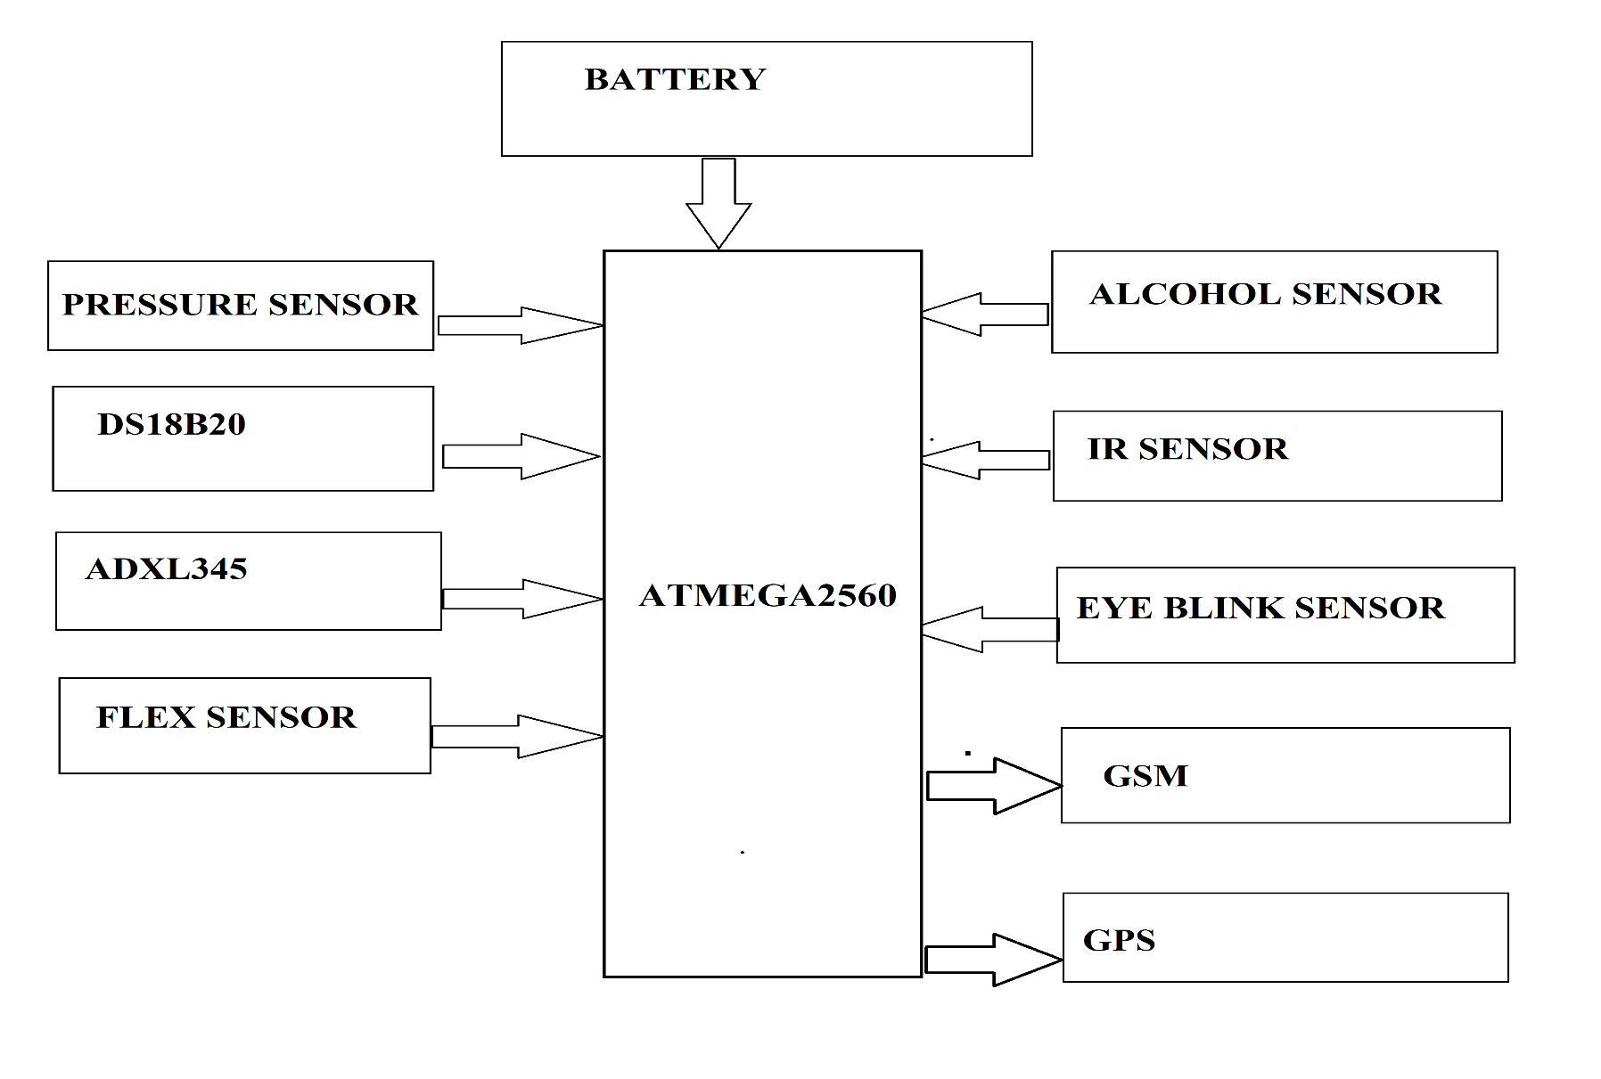
Block Diagram
Fig. 1 Block diagram of vehicle black box for accident data storage and alert system

Slide 11
Explanation of Block Diagram
Microcontroller (ATmega 2560): The microcontroller is the brain of the system. It controls all of the other components and processes the data from the sensors.
Sensors: The sensors in the system monitor the vehicle and the driver for signs of an accident. The sensors include an IR sensor for speed measurement, a pressure sensor for tire pressure, a DS18B20 sensor for vehicle and tire temperature, an alcohol sensor for driver alcohol level, an IR sensor for seat belt detection, an eye blink sensor for driver drowsiness detection, an ADXL345 accelerometer for accident detection, and a flex sensor for accident detection.
Buzzer: The buzzer is used to alert the driver if there is a problem with the vehicle or the driver.
GSM Module: The GSM module allows the system to send an alert message to emergency services if an accident is detected.
GPS Module: The GPS module provides the location of the vehicle in case of an accident.

Slide 12
Hardware and Software Requirements
H/W requirements:
ATmega2560
IR Sensor
Pressure Sensor
DS18B20 Sensor.
Alcohol Sensor
IR Sensor.
Eye Blink Sensor
Buzzer.
ADXL345 Sensor
Flex Sensor.
GSM Module
GPS Module
Power Supply
S/W requirements:
Arduino IDE
Proteus
EASY EDA

Slide 13
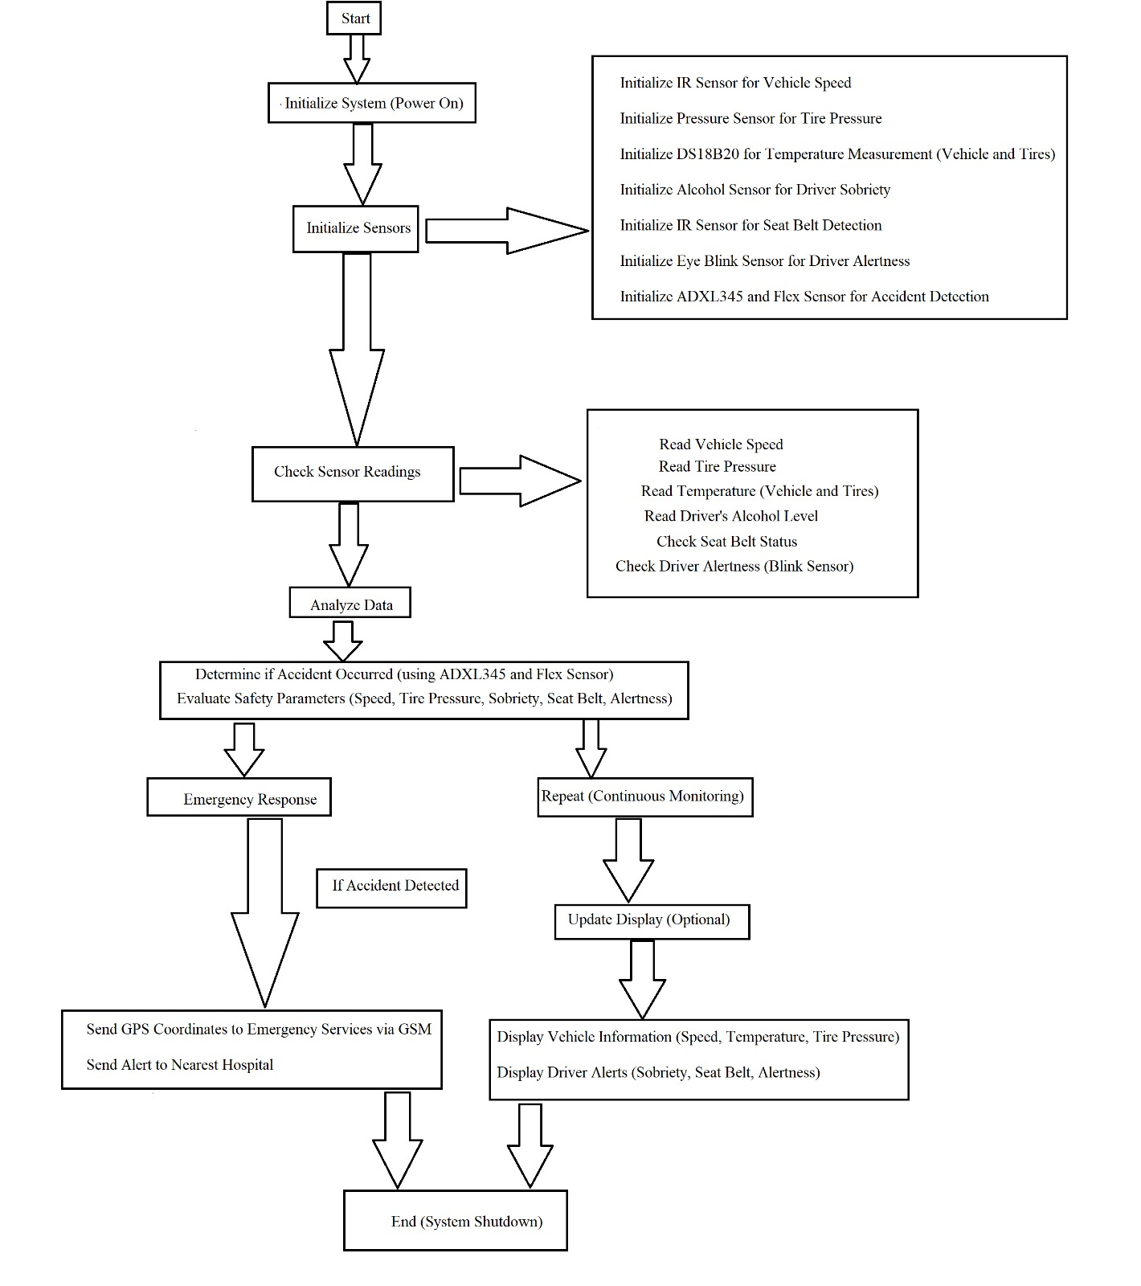
Flow chart

Slide 14
Detailed Algorithm
The sensors monitor the vehicle and the driver for signs of an accident.
The microcontroller collects data from the sensors and processes it.
If the microcontroller detects any signs of an accident, it will send an alert message to emergency services using the GSM module.
The GSM module will send the alert message to the emergency services along with the location of the vehicle (provided by the GPS module).
The emergency services will then be able to respond to the accident quickly and efficiently.

Slide 15
Conclusion
In conclusion, our project is a promising step towards enhancing road safety.
By leveraging advanced sensors and technology, we've developed a system that monitors critical aspects of both vehicles and drivers, aiming to prevent accidents and minimize their impact.
With its potential to save lives and improve road safety, our project signifies the power of technology in making our roads safer for everyone.

Slide 16
References
Smith, J. R., & Johnson, A. B. (2019). "Advanced Vehicle Safety Systems: A Comprehensive Review." International Journal of Automotive Engineering and Technologies, 8(3), 161-176.
Kumar, V., & Gupta, S. K. (2020). "Real-time Vehicle Accident Detection and Alert System using IoT and GSM." In 2020 5th International Conference on Computing, Communication and Security (ICCCS) (pp. 1-6). IEEE.
Li, W., Zhang, H., Li, X., & Li, M. (2020). "Vehicle Accident Detection and Intelligent Emergency Warning System." IOP Conference Series: Earth and Environmental Science, 519(1), 012035.
Saluja, V., & Mehta, P. (2019). "Vehicle Accident Detection and Avoidance System." International Journal of Scientific & Engineering Research, 10(11), 227-230.
Chen, S., Li, Z., & Xu, Y. (2018). "Design and Development of a Vehicle Collision Avoidance System Using IoT and Wireless Sensor Networks." Sensors, 18(7), 2133.
Choudhary, A., Shinde, V., Lokhande, A., & Zope, D. (2020). "Vehicle Accident Detection and Alert System using IoT and GPS." International Journal of Innovative Research in Science, Engineering and Technology, 9(3), 1318- 1325.

Slide 17
Sharma, R., Gupta, A., & Grover, A. (2017). "An Approach Towards a Vehicle Accident Detection and Alert System Using GPS and GSM Technology." International Journal of Computer Applications, 162(7), 1-4.
Yang, H. H., Chu, C. W., & Chen, Y. L. (2017). "Design and Implementation of Vehicle Accident Automatic Detection and Reporting System." IEEE Transactions on Industrial Informatics, 13(6), 3182-3190.
https://ww1.microchip.com/downloads/en/devicedoc/atmel-2549-8-bit-avrmicrocontroller-atmega640-1280-1281-2560-2561_datasheet.pdf. (9.00am).
https://www.allsensors.com/datasheets/DS-0376_Rev_A.pdf (9.24am) 11. https://cdn-shop.adafruit.com/datasheets/SIM808%20SPEC_20140325.pdf (9.50am)

Slide 18
Thank You!!!

